Slide 1
Pivotal Cloud Foundry Fundamentals
ORGS, SPACES, USERS, ROLES, CLI, API, APPS MANAGER
Platform Architecture Team

Slide 2


Cloud Controller API
Cloud Controller (CC) component of Cloud Foundry manages all APIs
CF CLI and other clients like Apps Manager directly call this API
Before accessing the CC API, you must get an access token from the User Account and Authentication (UAA) server
http://apidocs.cloudfoundry.org
Platform Runtime - Cloud Foundry
App Manager UI
HA Proxy LB
Application Manager
Dynamic Router
Cloud Controller
Blob Storage
UAA
Login Server
Diego
Auctioneer
BBS
CLI – Cmd Line Intf
Windows
Cell
Linux
Cell
Terminal Window
Rep
Rep
+
=
Messaging (NATS)
Metrics Collection
App Log Aggregator

Slide 3
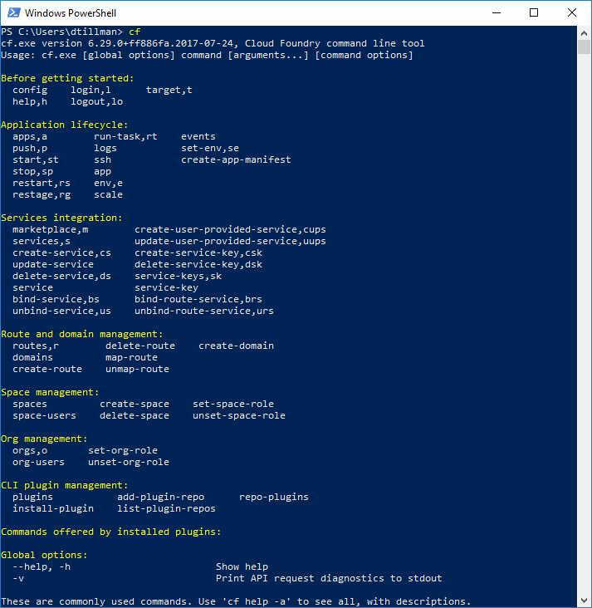
CLI – Command Line Interface
Command line utility providing easy access to the Cloud Controller (CC) API.
Scriptable
Fully documented
cf help –a
cf help <command>
cf api http://foo.bar.com
cf login <username>

Slide 4
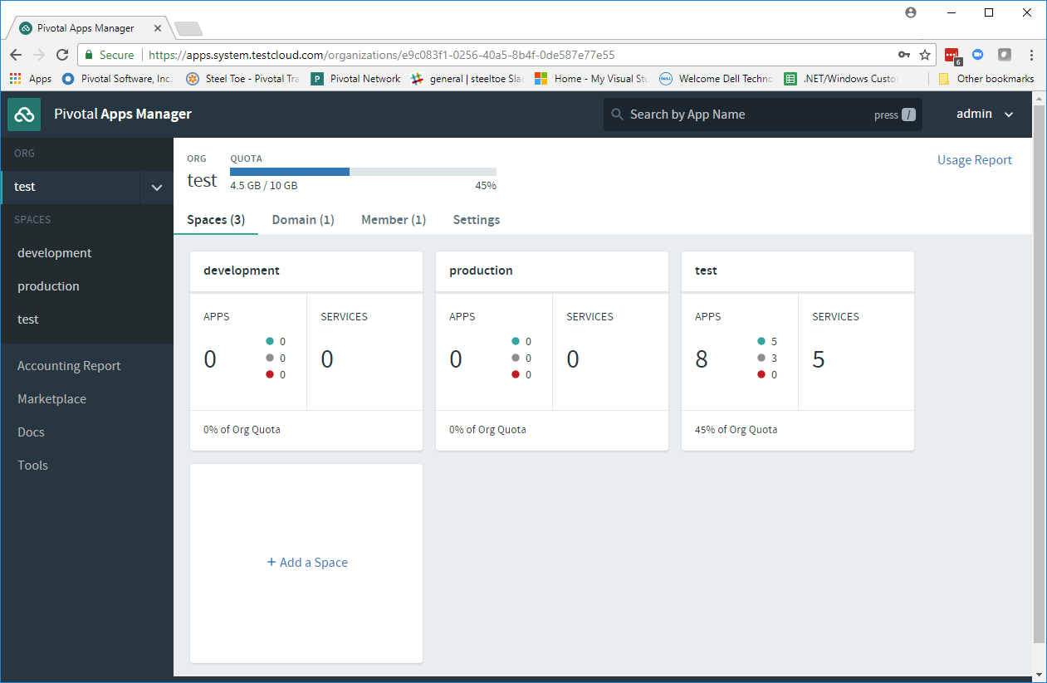
Pivotal Apps Manager
Manage Organizations, Users, Applications and Spaces
Monitor application logs, services and routes
Access Service Marketplace, create services and bind to applications

Slide 5
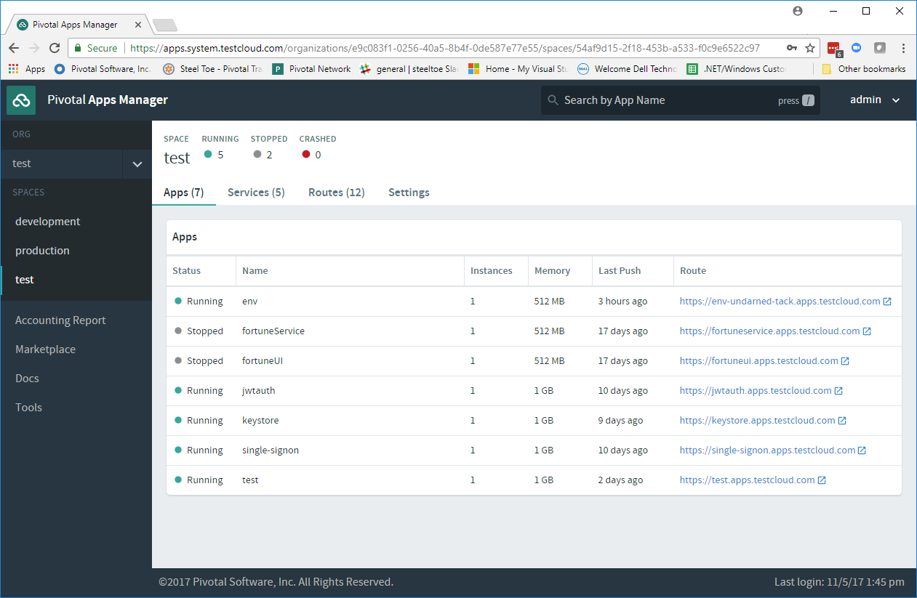
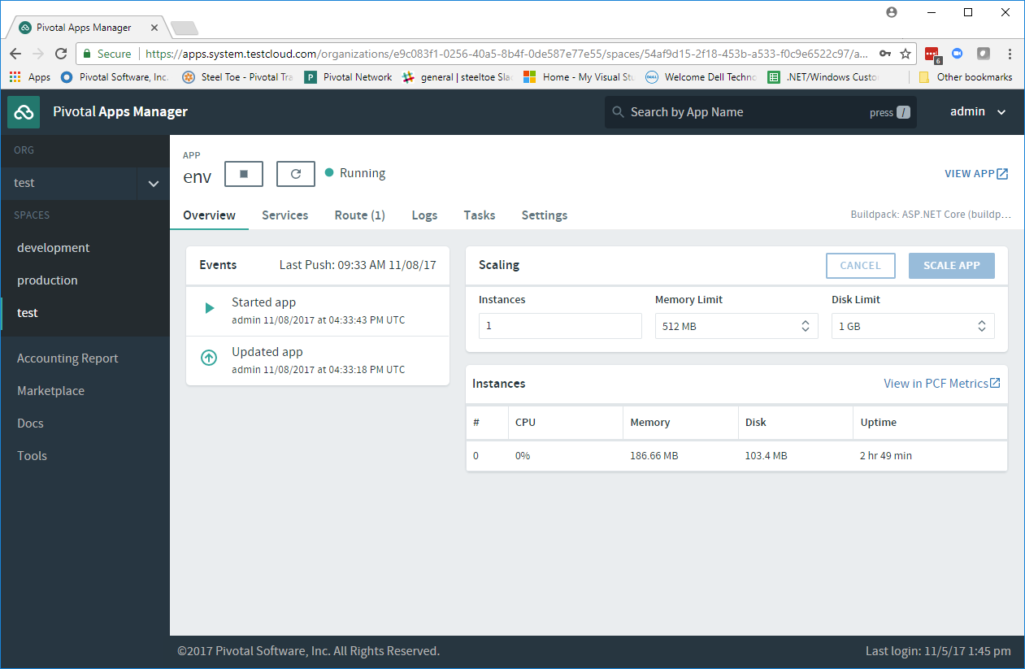
Pivotal Apps Manager – App View
Drill into a space to see all applications, services, routes and settings
Then drill into an application to see configuration, status, event, logging, routes, environment variables and service instances bound to the application

Slide 6
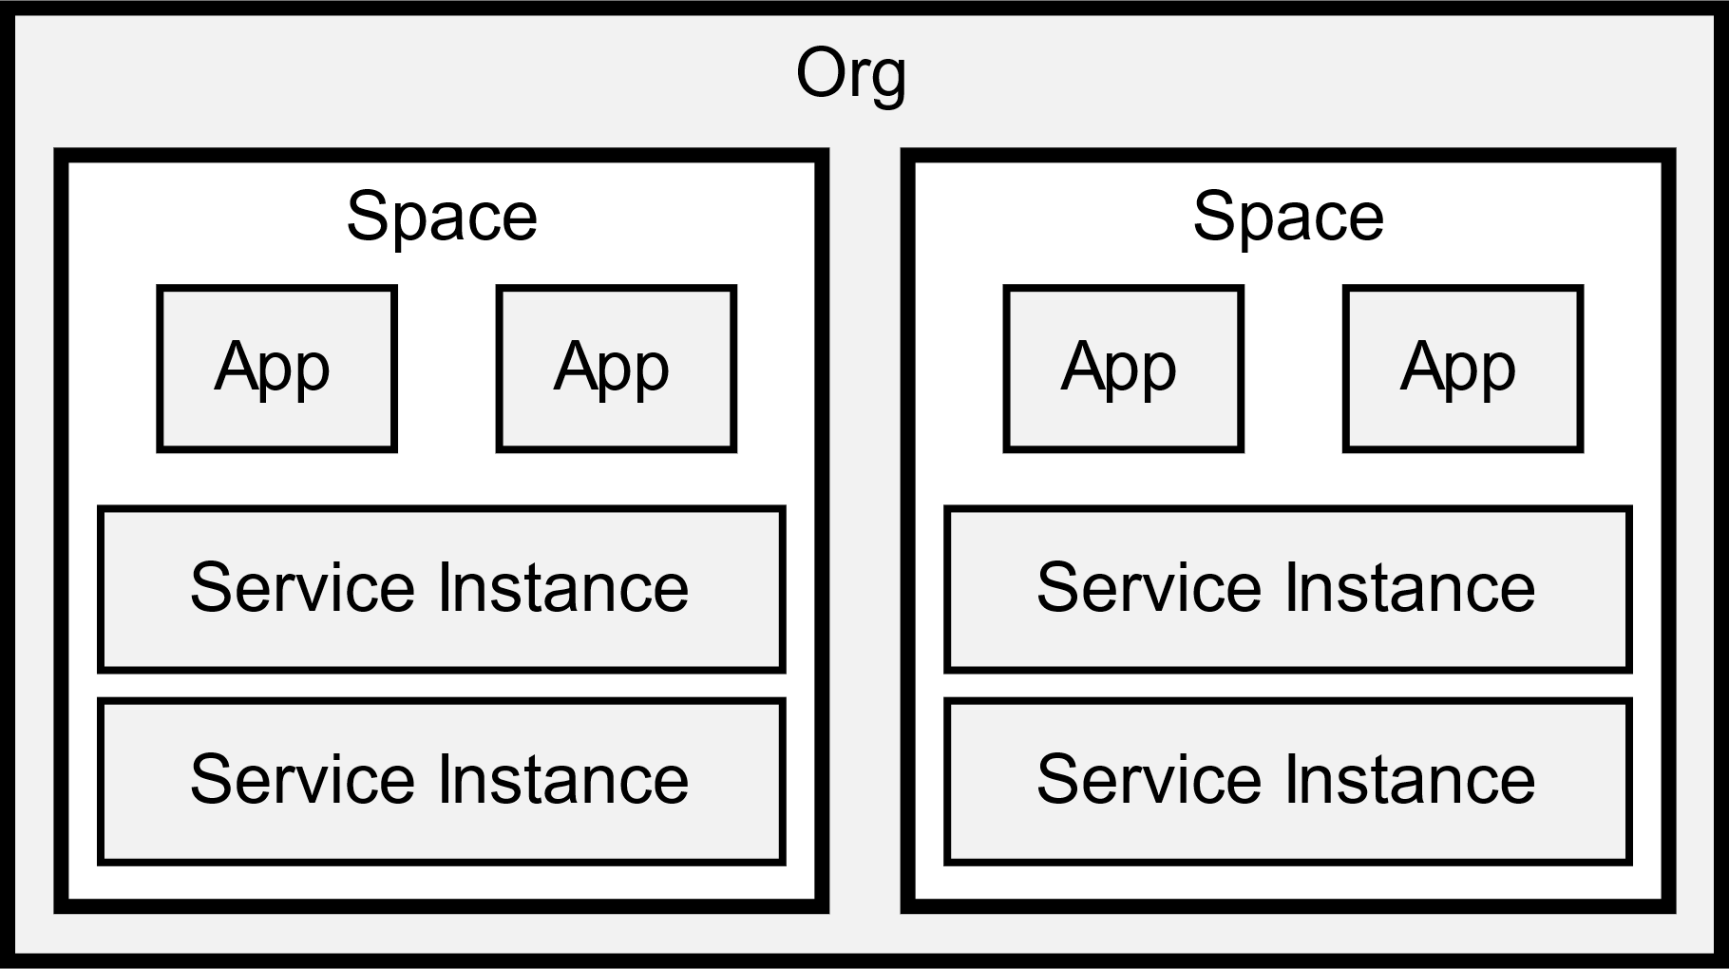
Notes:
Every application and service is scoped to a space. A space provides a set of users access to a shared location for application development.
cf spaces
cf space <some-space> # for details
Without a space, an application or service cannot be created. A space provides a set of users access to a shared location for application development. Each org must contain at least one space. If an org contains a single space, that space will be automatically targeted.
Run cf target to confirm your org and current space.
cf target

Slide 7
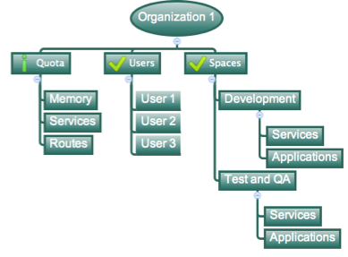
Apps Manager Fundamentals
Organizations
Top-most administrative unit
Logical division division within a PAS Foundation
Typically an application suite or large project
Each organization has its own users and assigned quota
User permissions / Roles are specified per space within an organization
Sub-divided into spaces

Slide 8
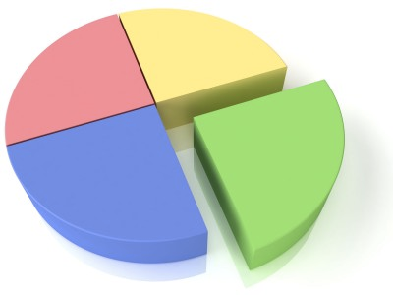
Apps Manager Fundamentals
Quota
Different quota limits (e.g. small, enterprise, default, runaway) can be assigned per Org
Quotas defines
Total Memory
Total # of services
Total # of Routes
Sub-divided into spaces

Slide 9

Apps Manager Fundamentals
Space
Logical subdivision within an organization
Users authorized at an organization level can have different roles per space
Services and Applications are created / target per Space
Same service name can have different meaning per space

Slide 10

Apps Manager Fundamentals
Users are members of an organization
Usually they are operators or developers (not application end users)
Users are associated by domain login
Users have specific organization and space roles
Organization roles grant permissions in an organization
Space roles grant permissions in a particular space
A combination defines the user’s overall permissions
Users and Roles

Slide 11
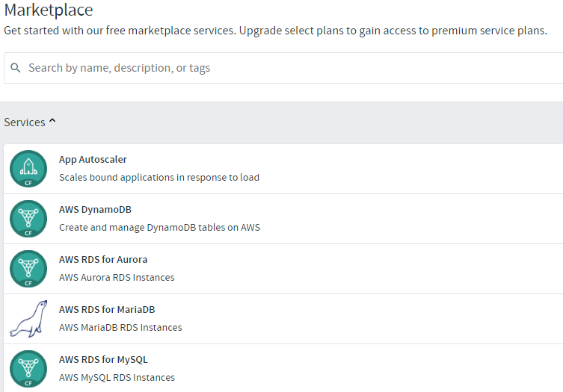
Apps Manager Fundamentals
Marketplace
Operators make services available for consumption
Predefined plans
Consume as environment variable connection string
Example services
Caching
Message Queue
Autoscaler
Create custom (user-defined) service

Slide 12

Transforming How The World Builds Software
© Copyright 2017 Pivotal Software, Inc. All rights Reserved.

